Slide 1
The idea behind this PowerPoint is to equip you with all the tools you need to make progress in terms of preparing for the world of work.
Careers Y11 Distanced learning

Slide 2
You already have a Career Portfolio, remember that the idea behind this is that you will build up key documents which you can use in a job search/show off at interview. You can see the type of things included from the Contents Page shown.

Slide 3
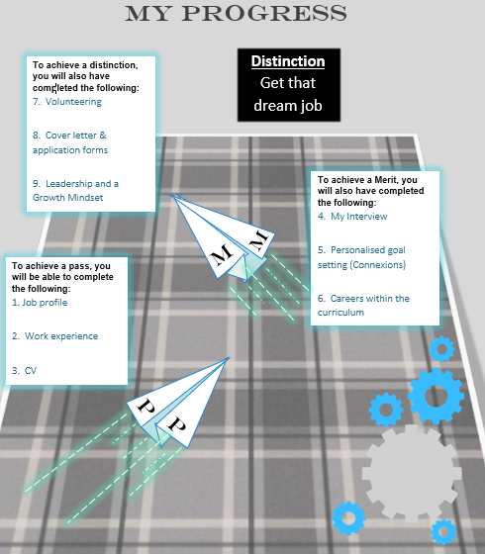
If you complete the Careers Portfolio to a good standard you can get certified. You can see from the picture that there are three levels of certification either a PASS, MERIT or DISTINCTION. You can see what needs to be completed to achieve each level.

Slide 4
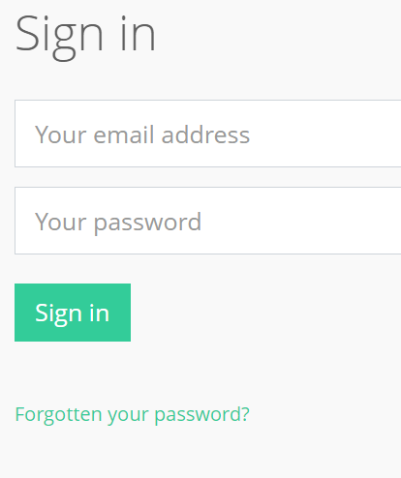
Hopefully you can all remember logging into Unifrog in Year 8. Your e-mail address was your schools e-mail and you set your own password. If you have forgotten your password then you can see that there is a ‘forgotten your password’ section for you to re-set. Please make sure that you can log-in to be able to complete the activity on the next slide.
ACTION!!!!
Session 1 is all about checking that you have completed the three first sections identified in slide 3. These three will earn you a PASS certificate (you might have already be done these).
Session 2 helps to prepare you for an interview.
Session 3 helps you to prepare a Covering Letter.

Slide 5
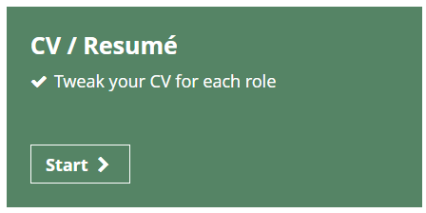
Once you have logged into Unifrog then you need to click on start on the box below.
You then need to click edit for each of the sections below, there is help available within most sections.
Give examples of when you have demonstrated these competencies
For work experience, it might be best to talk about where you would have liked to have gone

Slide 6
One of the issues that young people like yourselves are experiencing is a lack of experience. Thanks to Covid 19, traditional work experience placements were not possable. However this should not stop you researching job roles and gaining a further insight of what they involve.
Please use the blank slide on the next page to evidence your research. This can be in terms of screengrabs of the research that you have done / bullet points of different jobs/sectors/written paragraphs talking about what you want to do, why and the training/progression routes that you could take. Everyone is different, but the main thing is that you are actively researching what is out there.
Help
A good starting point could be to research the Careers Library in Unifrog.

Slide 8
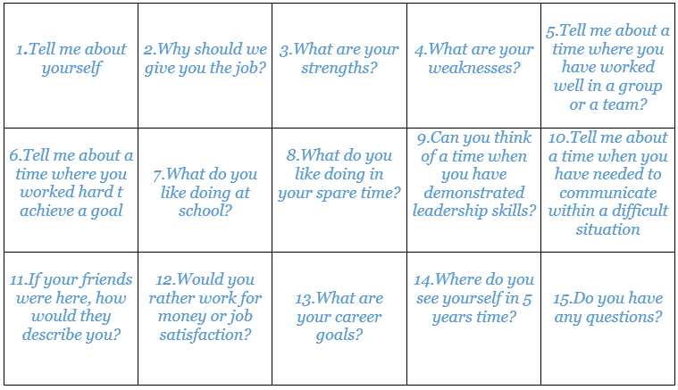
2
Please find opposite a list of questions that you could be asked at interview. You need to prepare your responses for each question on the next slide, think carefully about what employers will (and might not) want to hear.

Slide 9
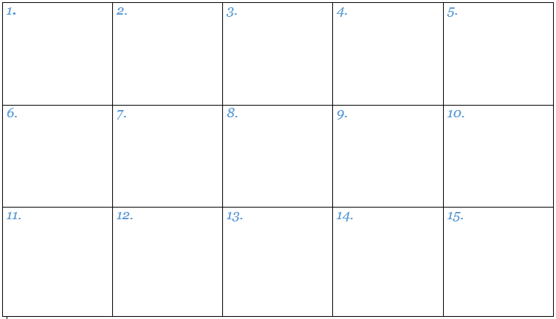
2

Slide 10
3
The Cover Letter

Slide 11
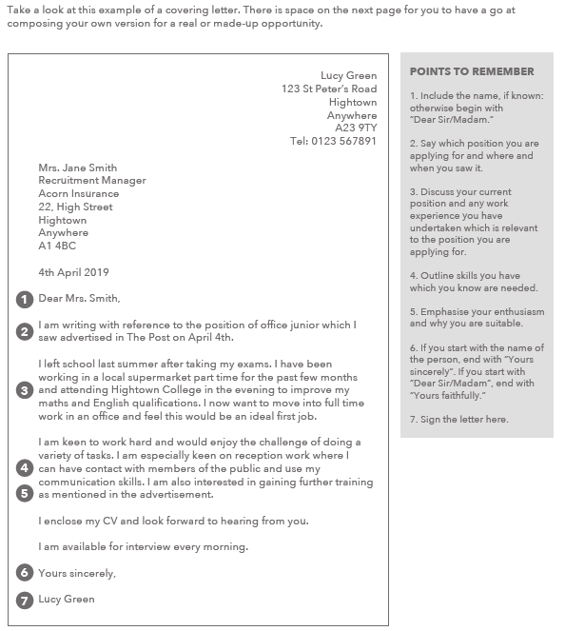
3
The Cover Letter

Slide 12
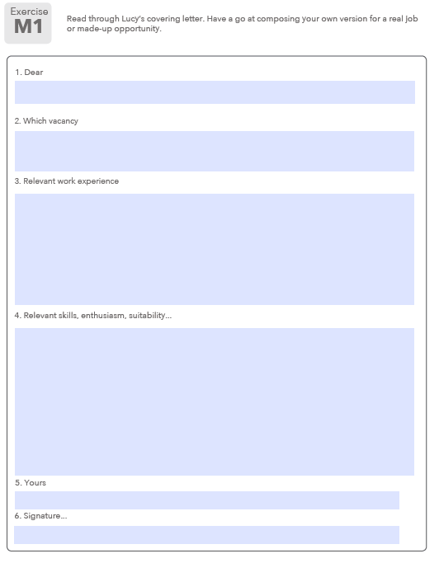
The Cover Letter
3
Complete a cover letter for yourself – either use this slide or complete it in Word (Word might be better as you can use it in the future). If you are struggling you can always find a job vacancy online to pretend to apply for, to give you focus.

Slide 13
Volunteering
ACTION!!!!
Use the internet to research volunteering opportunities within your local area.
Talk about the three most interesting opportunities on the next slide and explain why you feel they might be interesting to you.

Slide 14
Volunteering that suites me Name:
The first project that I would consider being involved in is:
The second project that I would consider being involved in is:
The third project that I would consider being involved in is:
Enter your information in this box
Enter your information in this box
Enter your information in this box
Enter the website link in this box
Enter the website link in this box
Enter the website link in this box
The reason that I feel this type of volunteering would suit me is:
The reason that I feel this type of volunteering would suit me is:
The reason that I feel this type of volunteering would suit me is:
Enter your information in this box
Enter your information in this box
Enter your information in this box

Slide 15
If you have completed each of the activities above then please have a go at completing the activities on the following pages that I have listed below. I have included quite an extensive list here as you may already have completed some of them in the booklet that you were working on in class:
Pages 19-21
Pages 8-14
Pages 28-30
Pages 3-7
Pages 24-26

